Slide 1

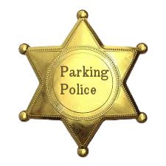
Parking Police Project
Laura Whelan, Leon Harmon, Moya Clarke

Slide 2

Project Objective
This project “Parking Police” will involve the analysis of images and evaluating if cars are parked “correctly”….
This involves:
Checking if a car has crossed the white boundary lines of the parking space
Identifying which car has crossed the white boundary lines

Slide 3
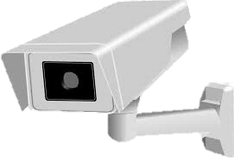
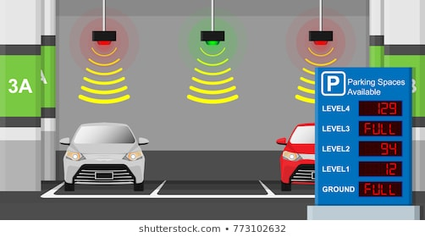
Project Application
This project is applicable to CCTV Cameras pointed at a Parking Lot from overhead. It could flag any poor parking to the "Parking Police".
The Parking Police could then incur fines on the driver of the car/ clamp the car for having parked "badly".
It could also be used in conjunction with parking space indicators so that the light flashes if poor parking has been detected.

Slide 4
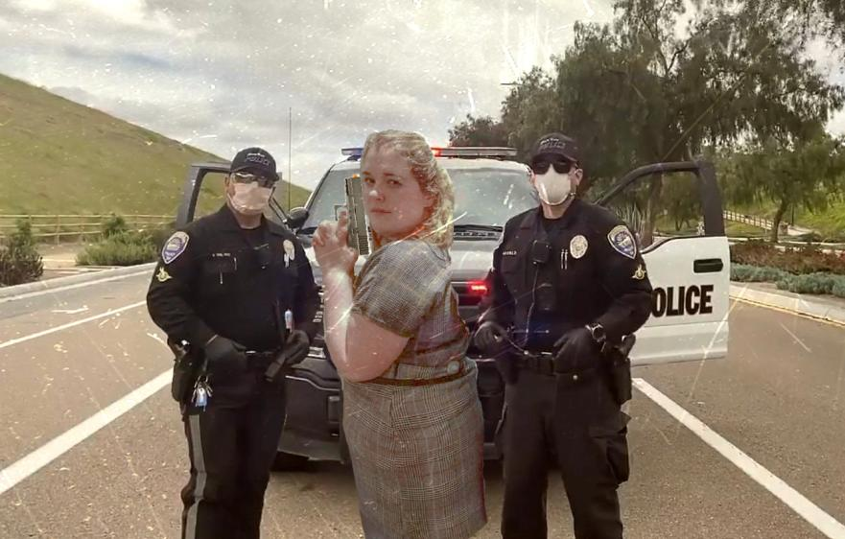
Lead Investigator Clarke
Blog Link

Slide 5
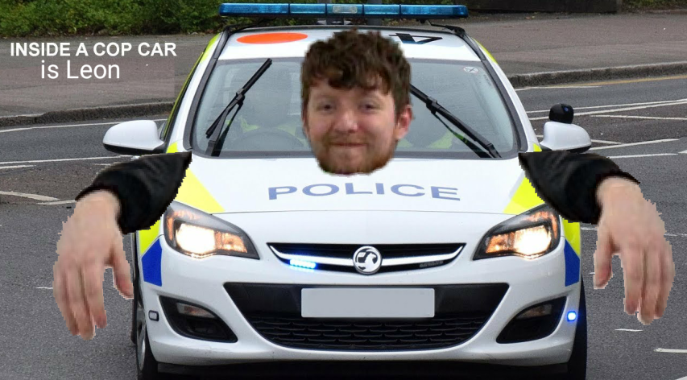
Commissioner Harmon
Blog Link

Slide 6
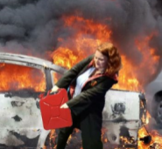
Chief Prosecutor Whelan
Blog Link

Slide 7
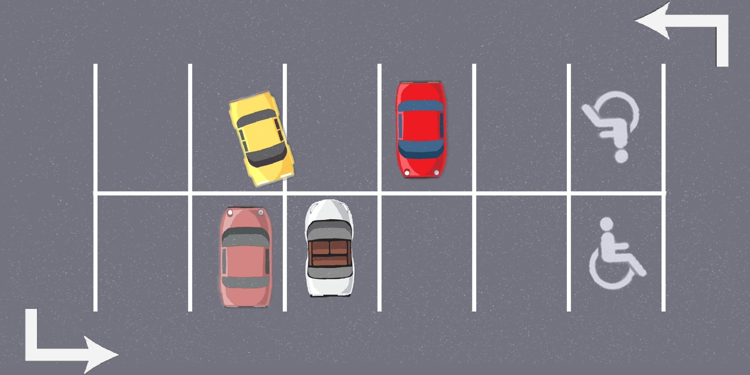
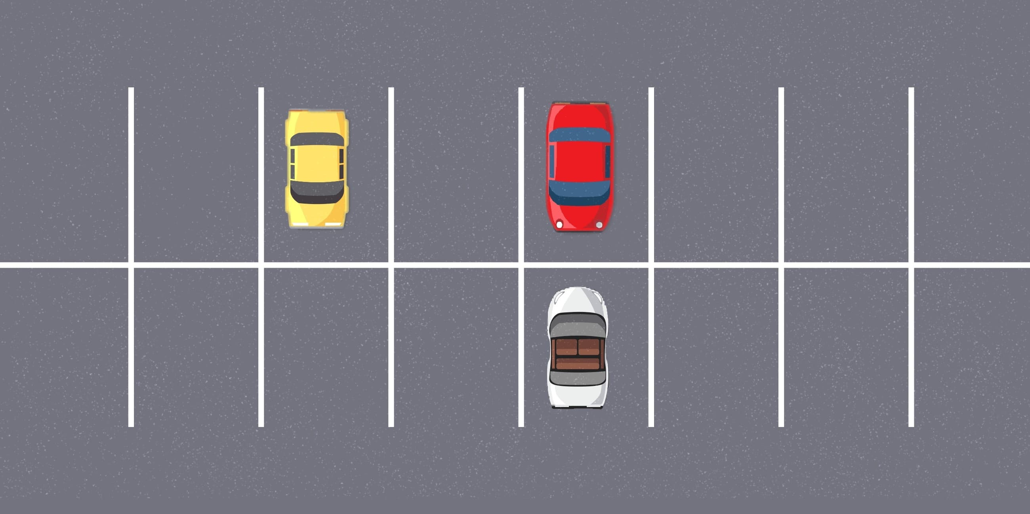
Parking Police code
We used our code to detect if any lines had been crossed by any cars, and if so, display which car broke the white boundary line
Boundary broken by top left car
No boundary broken

Slide 8
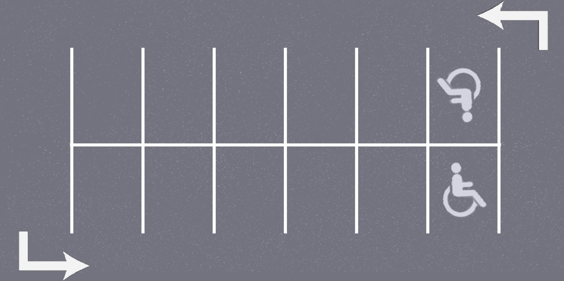
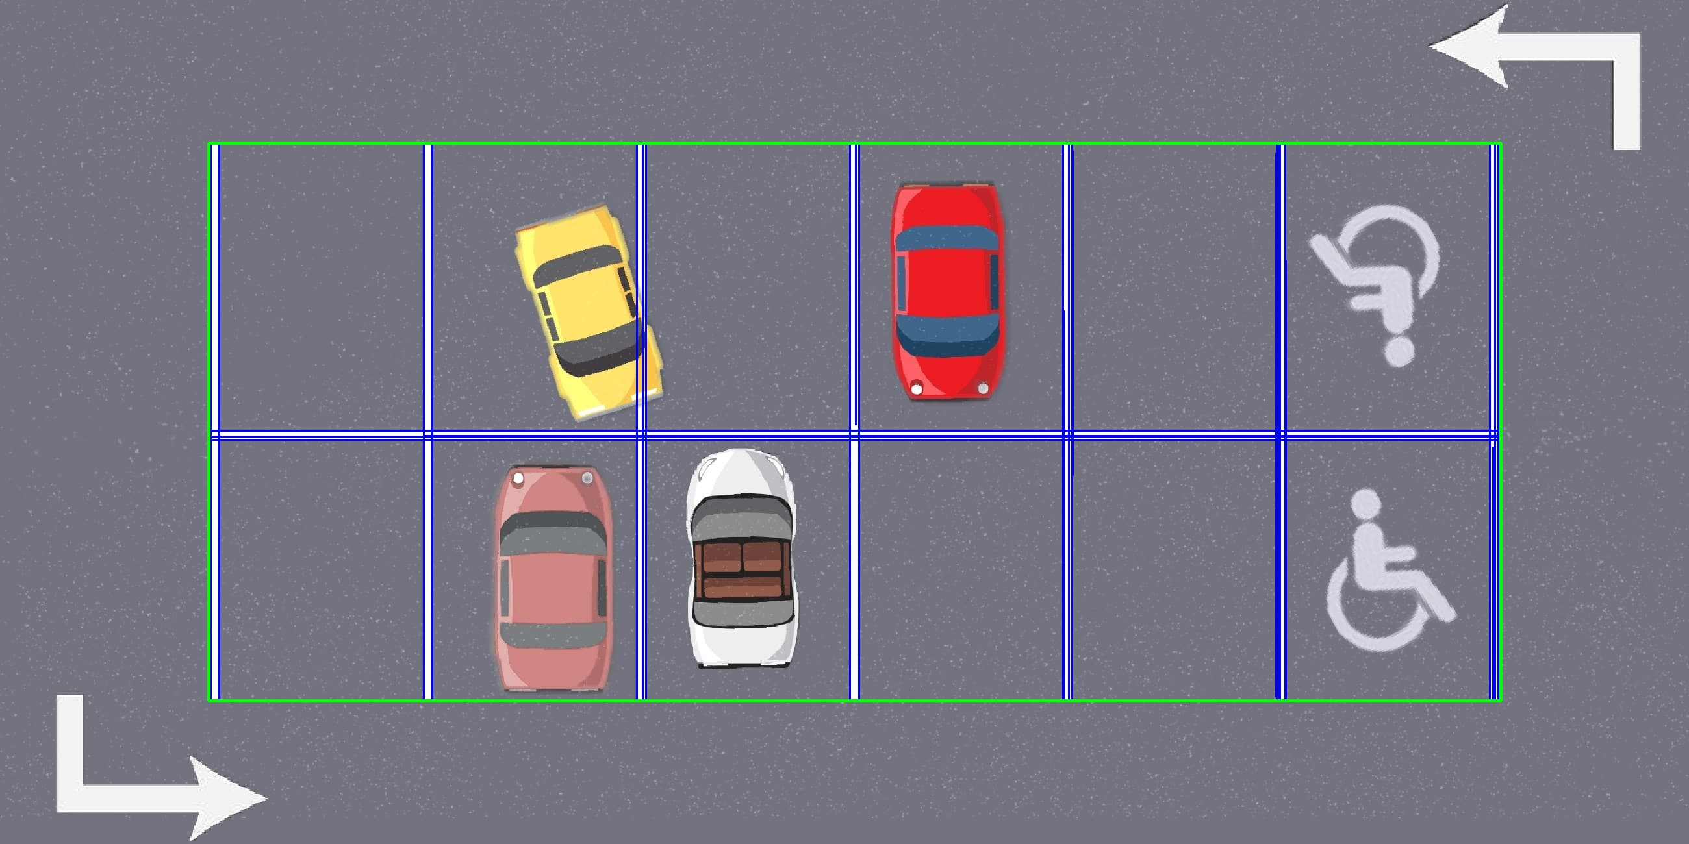
method
Prerequisite: Import Libraries & Declare Any Functions Used
Step 1: Read in Input Images
Step 2: Grayscale and Threshold Images
Step 3: Line Detection of Empty Car Park
Step 4: Determine Car Park Area from Lines Detected
Step 5: Draw Rectangle around Car Park Area
Step 6: Crop All Images to Car Park Area
Empty Car Park Image
Lines Detected and Car Park Area Shown

Slide 9
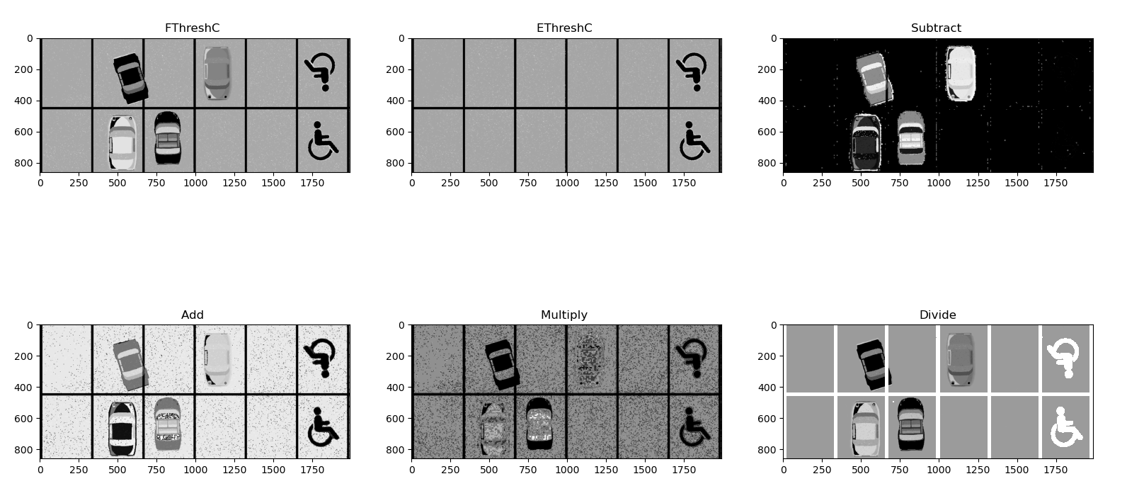

method
Step 7: Test Thresholds using Image Maths
Step 8: Plot Image Maths Outputs
Step 9: Prepare for Contours
Get Dimensions of Cropped Image
Create Blank Images of same size which are used later to print contours
Define shape used for morphology uses later
Image Maths
Blank Images

Slide 10
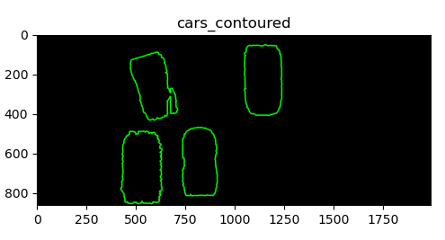
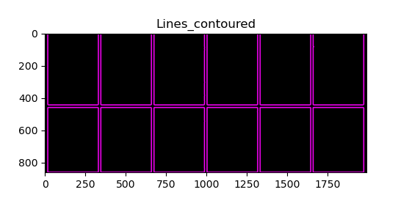
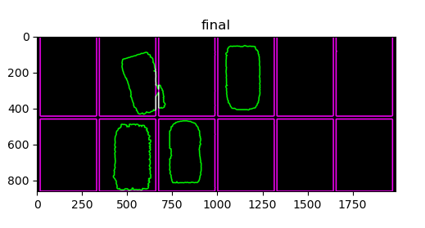
method
Step 10: Apply contours to cars
Step 11: Apply contours to Parking Area
Step 12: Draw contours and combine
Isolate cars from "subtract" image using shape
Find contours of cars
Separate each group of contours into an array for each car
Isolate lines from "EThreshC" using shape
Find contours of lines
Draw car contours in green (0,255,0)
Draw line contours in magenta (255,0,222)
Combine in "final" so that intersection of contours will be white (255,255,255

Slide 11
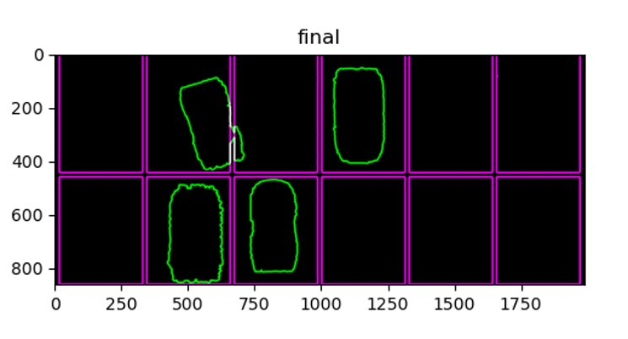

Slide 12

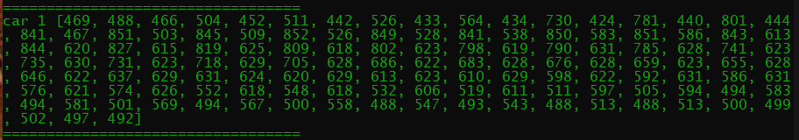
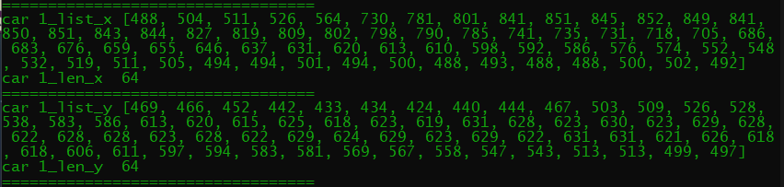
method
Step 13: Grayscale & threshold final image to find intersect coordinates
Step 14: Prepare Intersect coordinates lists
Step 15: Arrange Car Coordinates into x and y lists per car
Done by checking pixel by pixel where white is detected and adding those coordinates to an array
Breaks the Intersect coordinates array down into lists for the x and y elements
Threshold Final to find Intersect Coords
List of Elements in Car 1 list
List of Elements in Car 1 list broken down into X and Y

Slide 13
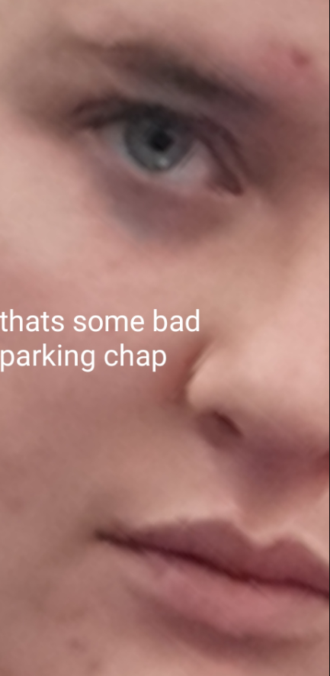
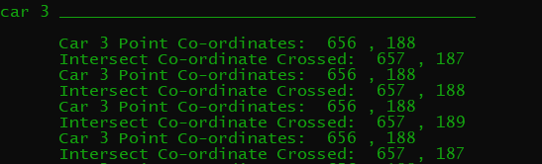
method
Step 16: Print out each car list for x and y co-ordinates
Step 17: Check which cars broke the line
Iterate through the x coordinates of each car, and if that x coordinate is present in the intersect x coordinates list, then it checks for a matching y that corresponds to that coordinate
This incorporates a "contour allowance" of one pixel which allows either the x or y coordinates or both, to be one pixel value away from what they are being compared to

Slide 14
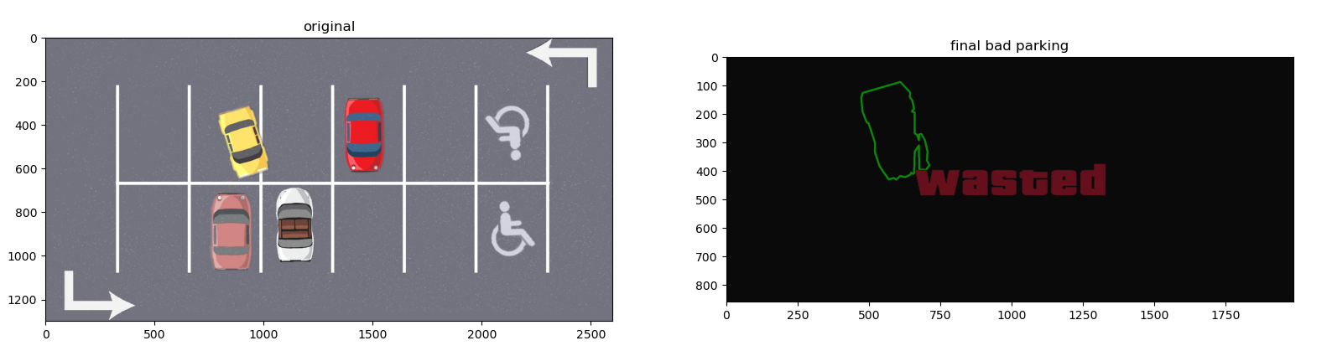
Method
Step 18: Produce Final Images
If no cars have crossed the boundaries, then one output is shown, alongside the original image
If a car or multiple cars have crossed the boundaries, then an output showing just the cars that crossed the boundary is shown
Boundaries Crossed Output

Slide 15
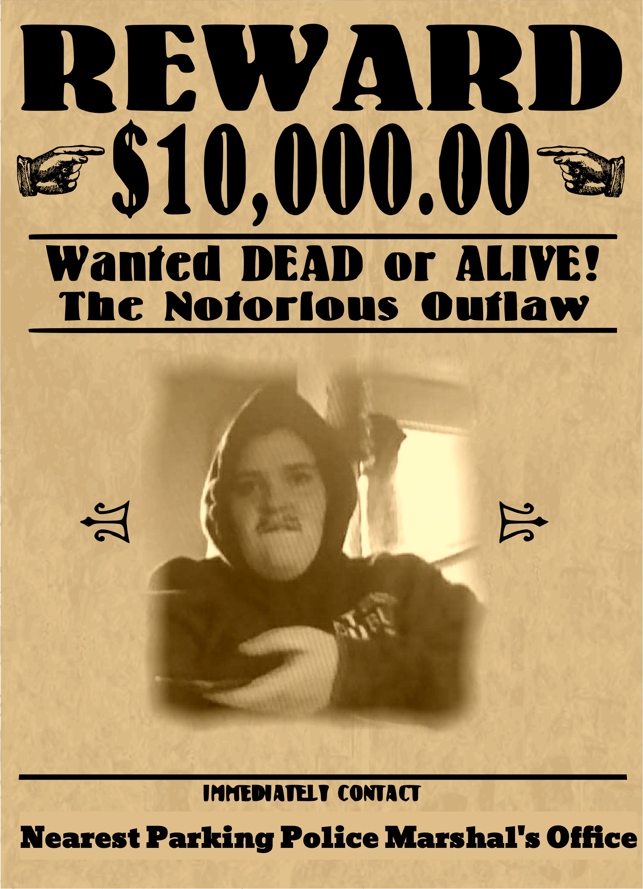
LIVE DEMO

Slide 16
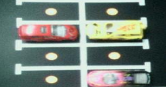
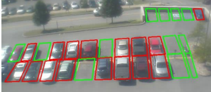
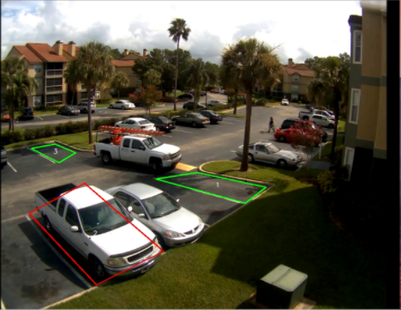
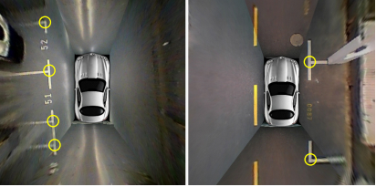
Research component
Click points, reference image of empty car park, physical sensors, google patent

Slide 17
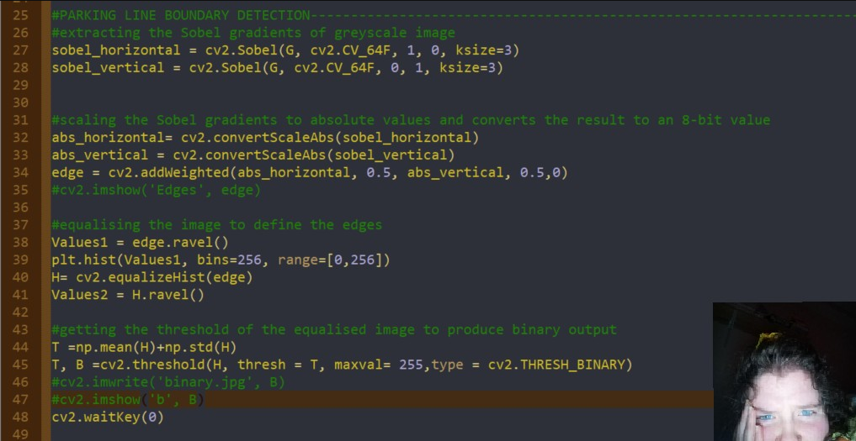
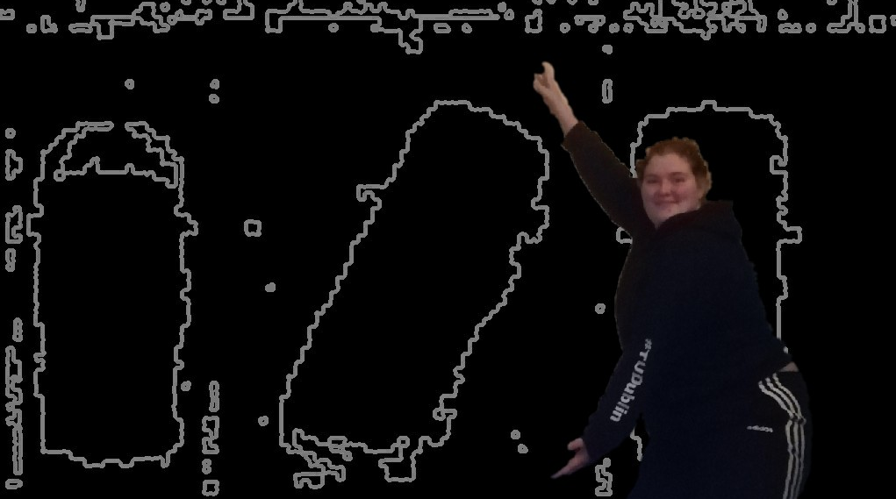
Code Graveyard

Slide 18
